Slide 1
Flux Capacitor Exercise

Slide 2
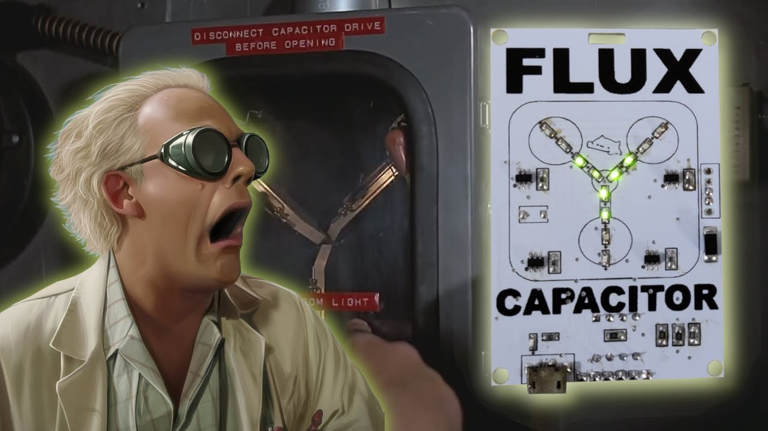

Slide 3
Describe the energy and change i.e. flux your program is experiencing post pandemic.
A capacitor stores electrical energy. Where do you want to use the energy in your program’s capacitor?

