Slide 1
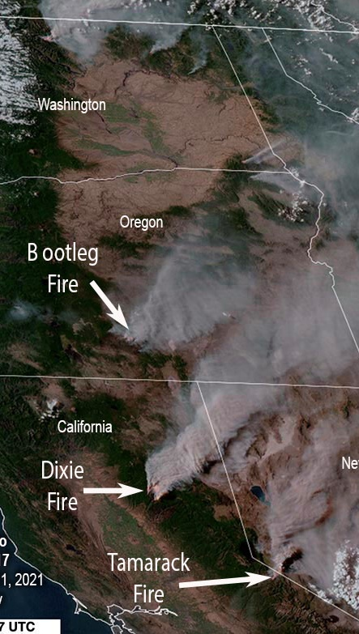





Nevada Air Quality Challenges When Wildfire Smoke Comes to Town
2023 SBEAP Annual Training
March 23, 2023
Presented by
Danilo Dragoni, Chief - Bureau of Air Quality Planning - NDEP
website.nv.gov l @NevDCNR

Slide 2
Presentation Outline
- - - - - - - - - - - - - - - - - - - - - - - - - - - - - - - - - - - - - - - - - - - - -
  Local Impact
    Ozone and PM_{2.5} AQI
  Clean Air Act
    National Air Quality Standards and Attainment Status
    Exceptional and Uncontrolled Events, Exceptional Event Demonstrations
    Mitigation Plans
  Communication Challenges
    Monitoring and Forecast
    NAAQS Forms, AQI vs. real-time observations
  Monitoring Wildfire Smoke in Nevada – Urban vs. Rural
    Desert Research Institute and NDEP research partnership
Notes:
Communication Challenges. - NAAQS forms, AQI, nowcast and real-time observations (Purple Air). Corrections… etc.

Slide 3
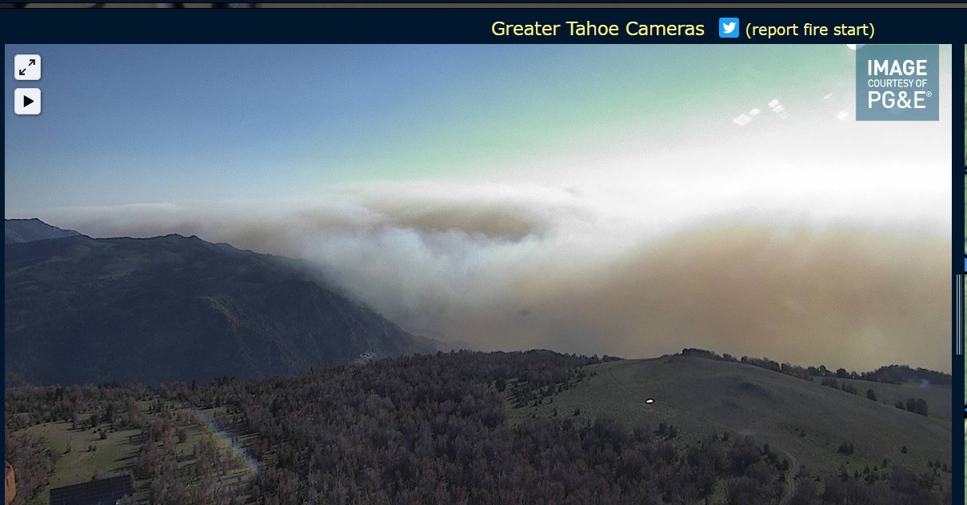
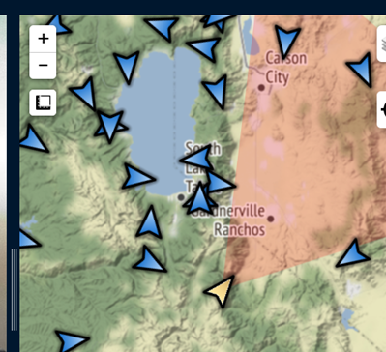
Sample Slide: Main Header
Sub-header (if applicable)
- - - - - - - - - - - - - - - - - - - - - - - - - - - - - - - - - - - - - - - - - - - - -
July 17, 2021 – approx. 7:30a

Slide 4
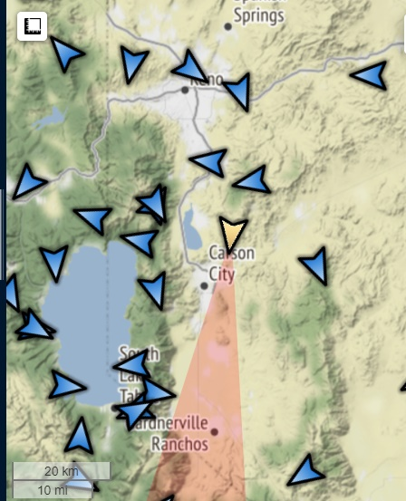
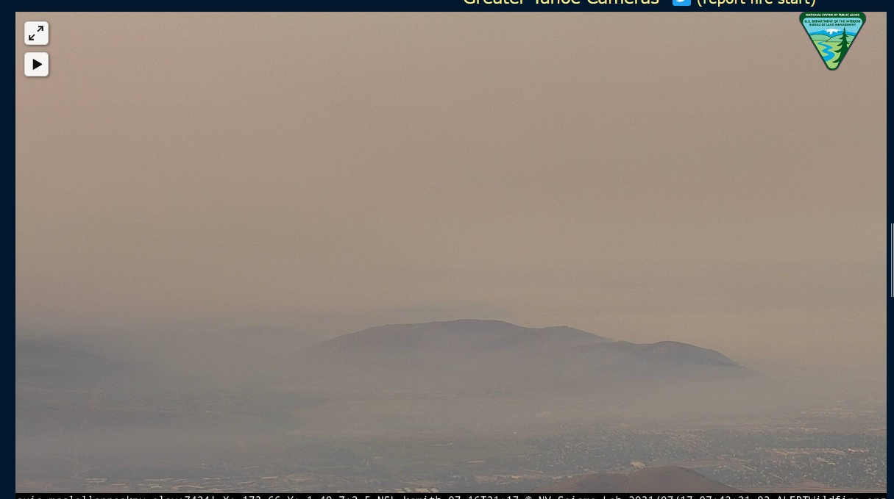
Sample Slide: Main Header
Sub-header (if applicable)
- - - - - - - - - - - - - - - - - - - - - - - - - - - - - - - - - - - - - - - - - - - - -
July 17, 2021 – approx. 7:30a

Slide 5
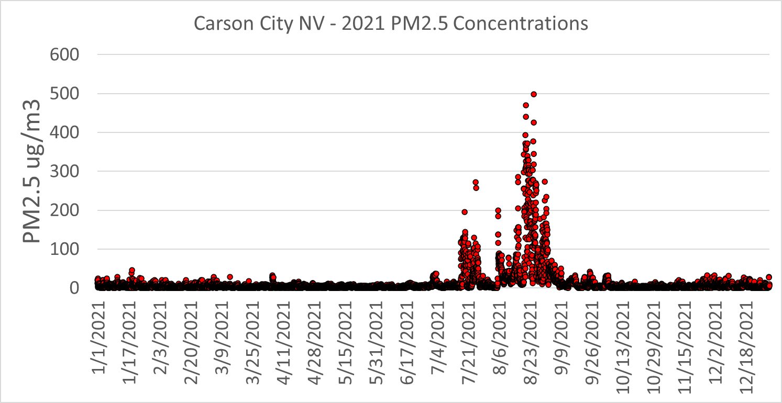
Wildfire Smoke - Impact
Fine Particulate Matter – Hourly Data
- - - - - - - - - - - - - - - - - - - - - - - - - - - - - - - - - - - - - - - - - - - - -
Caldor Fire
Tamarack Fire

Slide 6
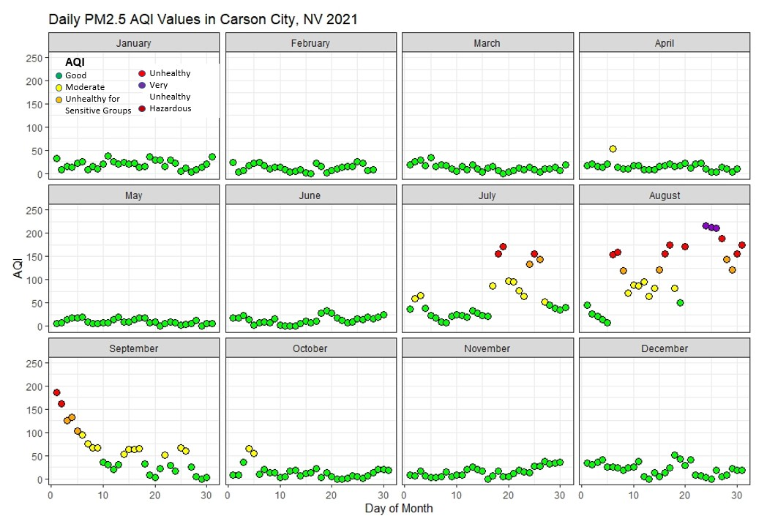
Wildfire Smoke - Impact
Air Quality Index (AQI)
- - - - - - - - - - - - - - - - - - - - - - - - - - - - - - - - - - - - - - - - - - - - -

Slide 7
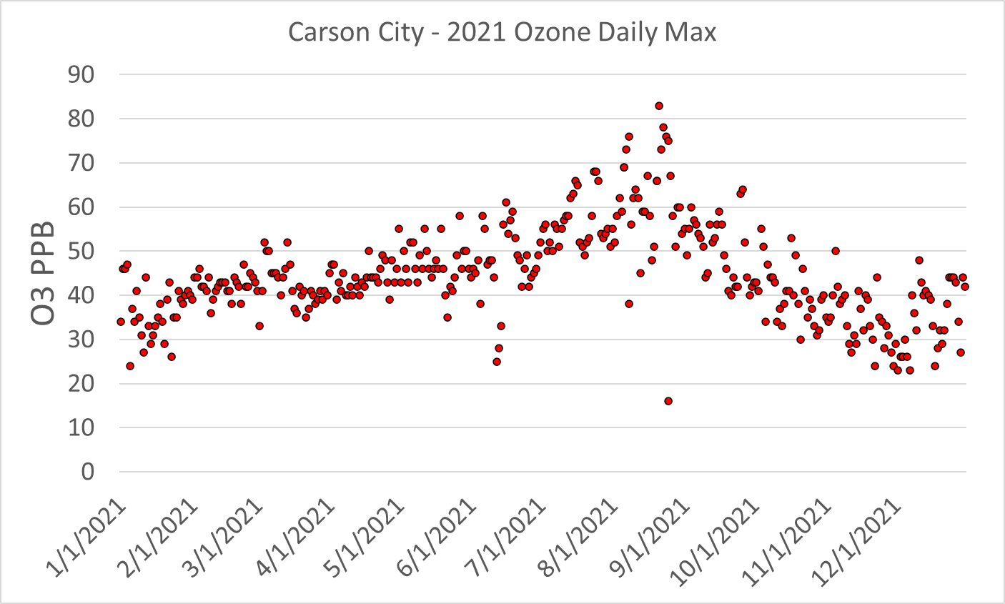
Wildfire Smoke Impact
Ozone
- - - - - - - - - - - - - - - - - - - - - - - - - - - - - - - - - - - - - - - - - - - - -

Slide 8
National Air Quality Standards
Primary PM_{2.5} and Ozone
- - - - - - - - - - - - - - - - - - - - - - - - - - - - - - - - - - - - - - - - - - - - -
NAAQS are health-based standards
Threshold and statistical forms are equally important
Pollutant | NAAQS | Future?
PM2.5 24-Hour (98th percentile averaged over 3 years) | 35 ug/m3 | Same?
PM2.5 Annual (averaged over 3 years) | 12 ug/m3 | 2023 9-10 ug/m3
Ozone 8-Hours (fourth-highest daily maximum 8-hours, averaged over 3 years) | 70 ppb | 2024? Lower, 65ppb?
Notes:
Difference between the monitor values and the NAAQS.

Slide 9
National Air Quality Standards
Designation Classification
- - - - - - - - - - - - - - - - - - - - - - - - - - - - - - - - - - - - - - - - - - - - -
Classification | Level | Requirements
Attainment/Unclassifiable |  | Maintaining attainment Less stringent federal requirements on major stationary emission sources
Nonattainment (based on severity of exceedance but also on length of nonattainment status) | Marginal (3 year to attain) Moderate (6 years) Serious (9 years) Severe (15-17 years) Extreme (20 years) | More stringent federal requirements on major stationary sources (controls and thresholds) Emission offsets (1.1, 1.15, 1.2, 1.3 , 1.5)
Notes:
Threshold to be major are lower… and offset are higher

Slide 10
Attainment Designation
State Implementation Plans, and Exceptional Events
- - - - - - - - - - - - - - - - - - - - - - - - - - - - - - - - - - - - - - - - - - - - -
1 Year After
Recommendation for designation and EE package
3 Years After
Infrastructure SIP
Promulgation of NAAQS
3-4 years
Monitoring data used for designation
Latter of either July 1st or January 1st
Initial Notification of exceptional events (EE)
2 Years After
EPA makes designations
18 months after nonattainment designation
Nonattainment SIP

Slide 11
Exceptional Events
Definition
- - - - - - - - - - - - - - - - - - - - - - - - - - - - - - - - - - - - - - - - - - - - -
  Clean Air Act, 42 U.S.C. § 7619(b) (as amended in August 2005)
  (i) affects air quality;
  (ii) is not reasonably controllable or preventable;
  (iii) is an event caused by human activity that is unlikely to recur at a particular location or a natural event; and
  (iv) is determined by the Administrator through the process established in the regulations promulgated under paragraph (2) to be an exceptional event.
  EPA
  Exceptional Events are unusual or naturally occurring events that can affect air quality but are not reasonably controllable using techniques that tribal, state or local air agencies may implement in order to attain and maintain the National Ambient Air Quality Standards.

Slide 12
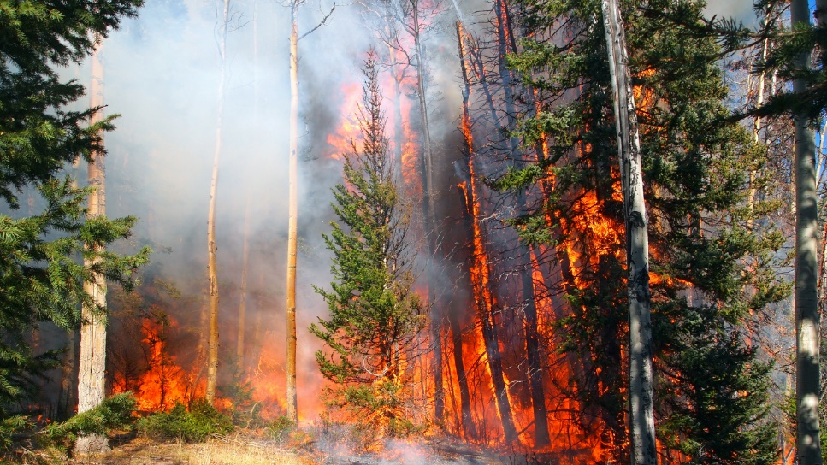
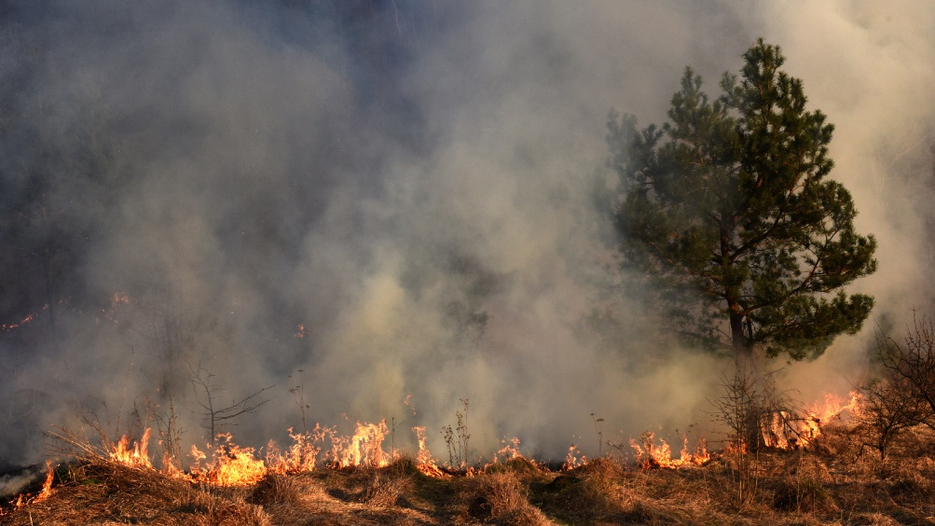
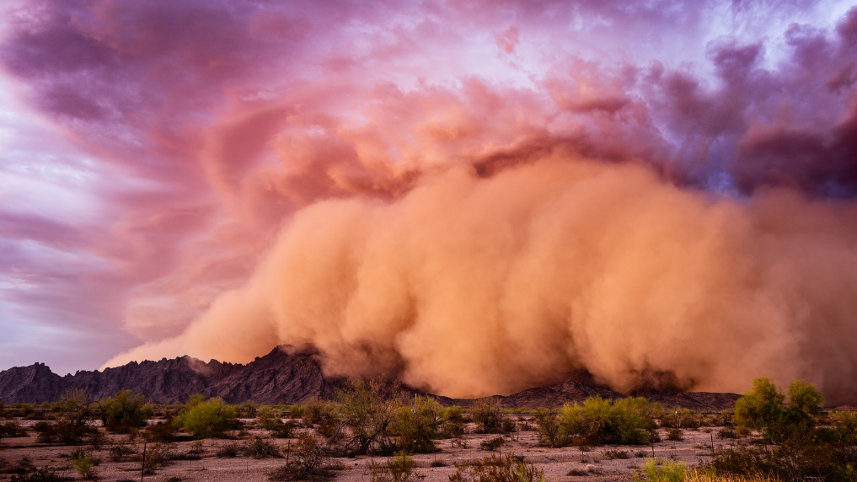
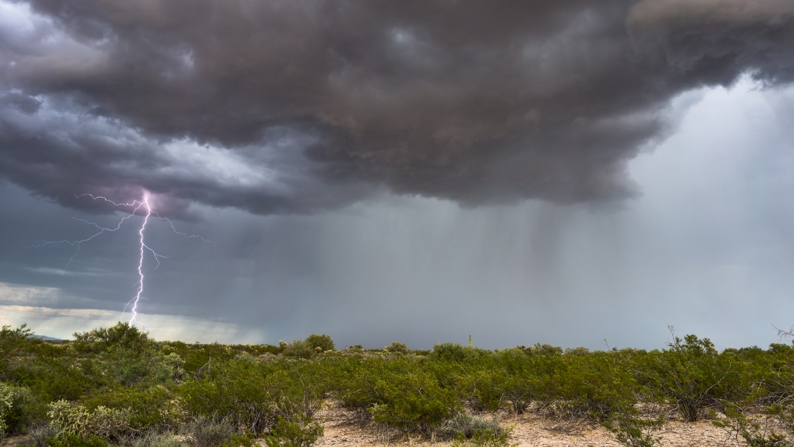
Exceptional Events
Examples
- - - - - - - - - - - - - - - - - - - - - - - - - - - - - - - - - - - - - - - - - - - - -
  Wildfires (PM2.5 and Ozone)
  Prescribed Fires (PM2.4 and Ozone)
  High Winds (PM10)
  Stratospheric Intrusions (Ozone)

Slide 13
Exceptional Events
demonstrations
- - - - - - - - - - - - - - - - - - - - - - - - - - - - - - - - - - - - - - - - - - - - -
  40 CFR Part 50 and 51 – Treatment of Data Influenced by Exceptional Events (2016)
  The event affected air quality in such a way that there exists a clear causal relationship between the specific event and the monitored exceedance or violation
  The event was not reasonably controllable or preventable
  The event was caused by human activity that is unlikely to recur at a particular location or was a natural event
Notes:
Clear causal relationship. Demonstration that the pollution came from a specific event (wildfire) and reached a specific monitor. Smoke travel hundreds of miles. Compounding effects of several fires. And for ozone, is unclear the impact of wildfires. Bottom line, it’s a lot of work.
Number of EE for 2021 – douzens?
Are wildfires natural events? Can lighting strikes the same spot twice? What about forest management?

Slide 14
Exceptional Events
Mitigation Plans
- - - - - - - - - - - - - - - - - - - - - - - - - - - - - - - - - - - - - - - - - - - - -
  States requesting to exclude data due to exceptional events must take measures to protect public health. For areas with historically documented or known season exceptional events, air agencies must develop mitigation plans.
  Public notification and education programs.
  Steps to identify, study, and implement mitigation measures
  Periodic review and evaluation of the mitigation plan and its implementation and effectiveness

Slide 15
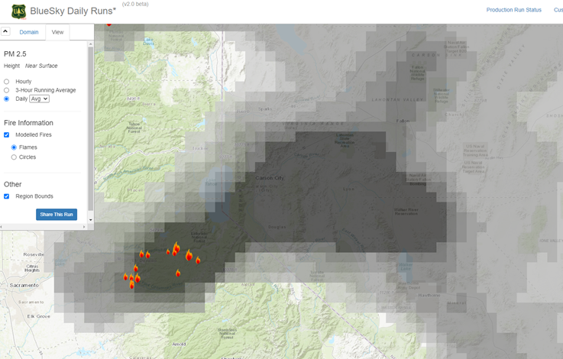
Communication Challenges
During Wildfire Smoke
- - - - - - - - - - - - - - - - - - - - - - - - - - - - - - - - - - - - - - - - - - - - -
  Current and future air quality conditions are the most critical piece of information that we can provide during periods impacted by wildfire smoke
  Accuracy of prognostic models (time and space)
  Timing of air quality forecast (daily)
  Raw measurements to final product
    Concentrations
    AQI
    Delay in processing and ‘publication’
  Location of monitors (filling the gaps)
  Comparison with low-cost personal sensors (accuracy and corrections)
  Air Quality impacted by multiple pollutant (ozone and/or PM)
  Consistency and uniformity in the information provided (AirNow.gov)
Notes:
People are looking to answer questions like “can I do baseball practice”, can I go outside, there will be baseball practice at 4pm, or tomorrow? Emergency Managers, school districts, etc.
Prognostic models rely on principles that are very similar to our weather forecast…. And smoke can be very variable. In space and time

Slide 16
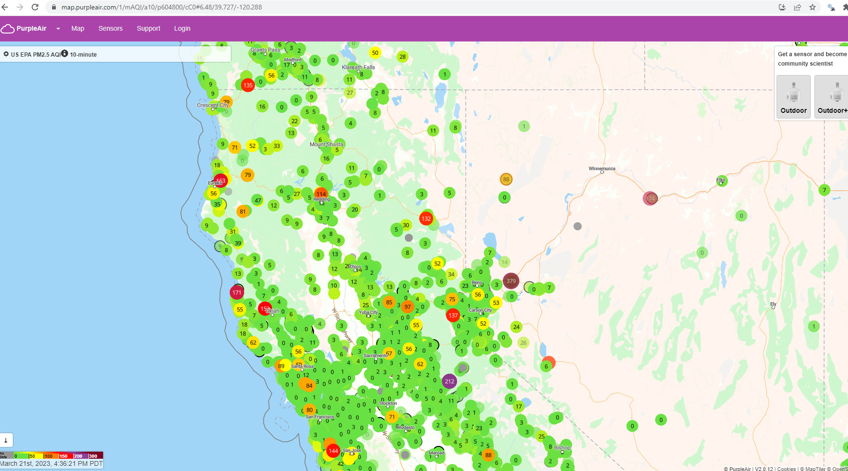
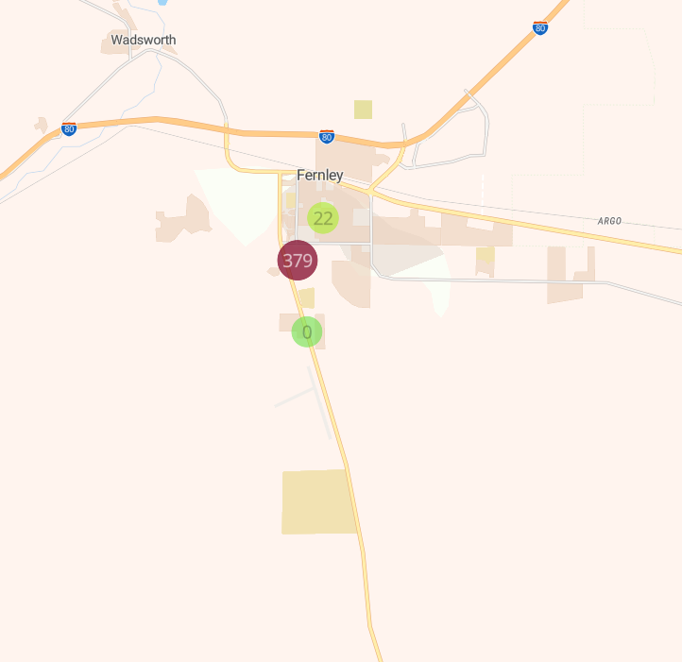
Communication Challenges
During Wildfire Smoke – Low Cost Sensors
- - - - - - - - - - - - - - - - - - - - - - - - - - - - - - - - - - - - - - - - - - - - -
From AirPurple.com
Notes:
People are looking to answer questions like “can I do baseball practice”, can I go outside, there will be baseball practice at 4pm, or tomorrow? Emergency Managers, school districts, etc.
Prognostic models rely on principles that are very similar to our weather forecast…. And smoke can be very variable. In space and time

Slide 17
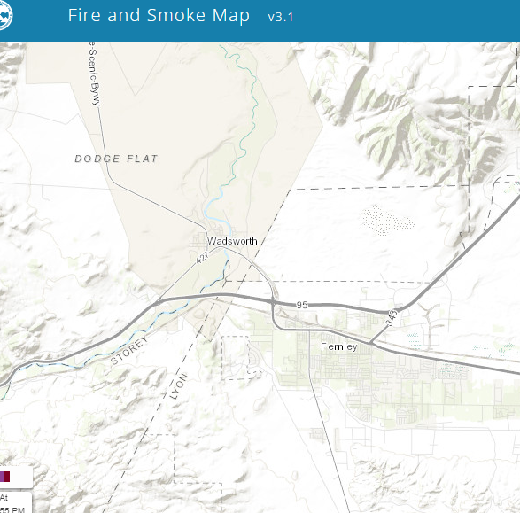
Communication Challenges
During Wildfire Smoke – Low Cost Sensors
- - - - - - - - - - - - - - - - - - - - - - - - - - - - - - - - - - - - - - - - - - - - -
https://fire.airnow.gov/
From AirPurple.com
Notes:
People are looking to answer questions like “can I do baseball practice”, can I go outside, there will be baseball practice at 4pm, or tomorrow? Emergency Managers, school districts, etc.
Prognostic models rely on principles that are very similar to our weather forecast…. And smoke can be very variable. In space and time

Slide 18
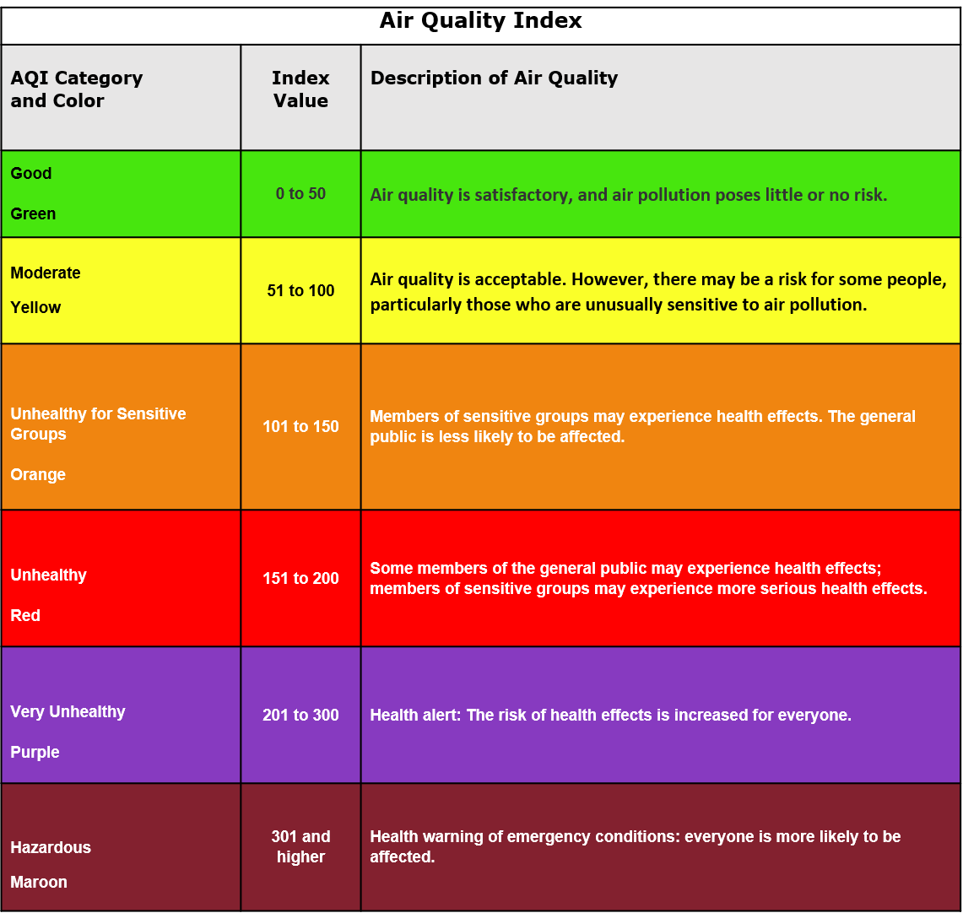
Communication Challenges
Air Quality Index
- - - - - - - - - - - - - - - - - - - - - - - - - - - - - - - - - - - - - - - - - - - - -
  Health-base, Uniform, normalized, color-coded index
  Tries to bridge between real-time observations and NAAQS.
  EPA and Air Quality Agencies provide daily AQI for forecast, and ‘nowcast’ for ‘real-time’ information
  The nowcast AQI (AirNow.gov) is a statistical approach that uses the past 12 hours to convey the health risk for the current hour.
  For wildfire smoke, in particular nearby wildfires (like in 2021), smoke conditions can change very rapidly.
  Difference between observed and/or perceived air quality conditions and AQI

Slide 19
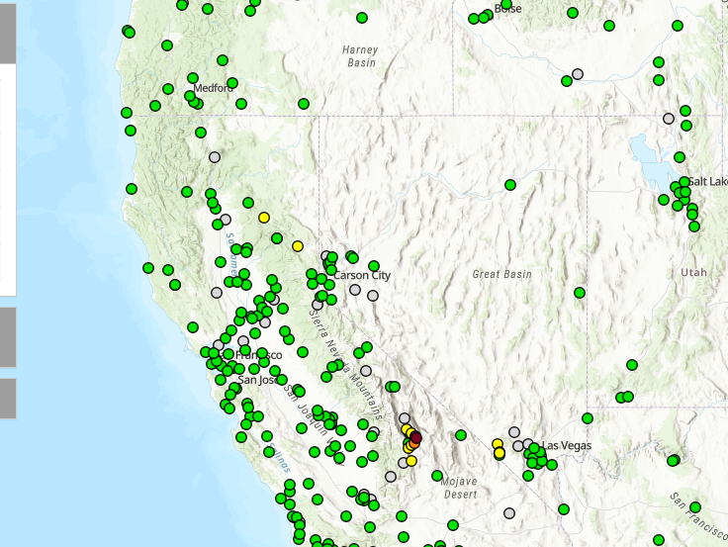
Monitoring in Nevada
Urban vs. Rural
- - - - - - - - - - - - - - - - - - - - - - - - - - - - - - - - - - - - - - - - - - - - -
  Regulatory Monitors
Source: AirNow.gov
Notes:
AirNow Ozone and PM2.5 NowCast

Slide 20
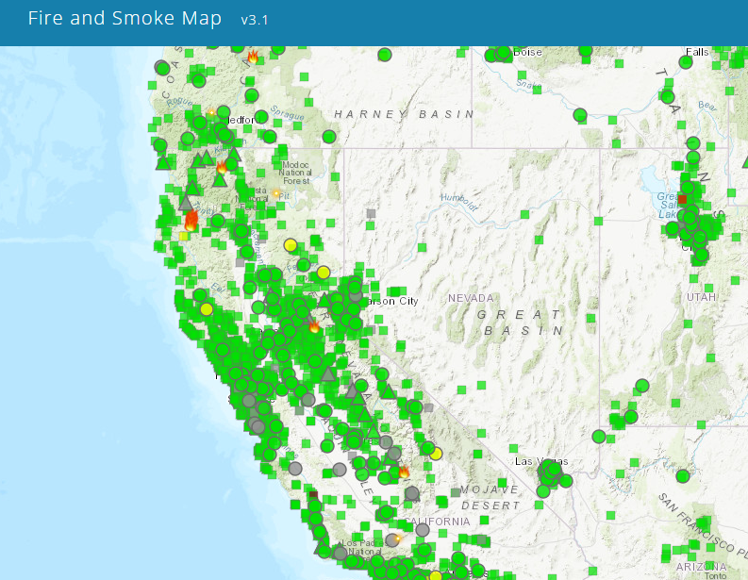
Monitoring in Nevada
Urban vs. Rural
- - - - - - - - - - - - - - - - - - - - - - - - - - - - - - - - - - - - - - - - - - - - -
  Public Sensors
  Regulatory
  Low-cost personal
Source: fire.airnow.gov

Slide 21
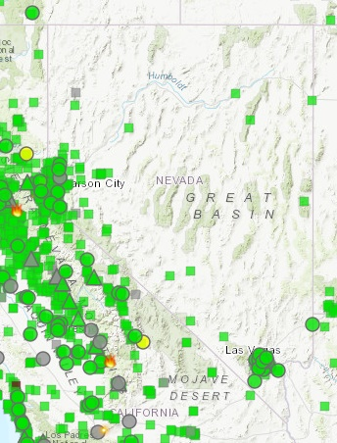
Monitoring Nevada
Urban vs. Rural
- - - - - - - - - - - - - - - - - - - - - - - - - - - - - - - - - - - - - - - - - - - - -
  Population Centers

Slide 22
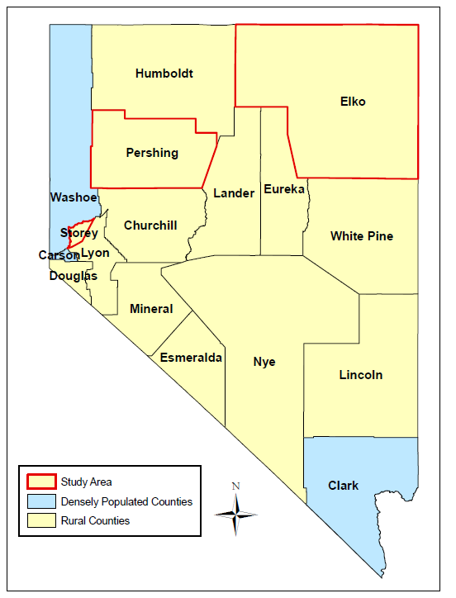

Desert Research Institute – NDEP collaboration
Expanding Wildfire Smoke Monitoring and Messaging into Rural Nevada
- - - - - - - - - - - - - - - - - - - - - - - - - - - - - - - - - - - - - - - - - - - - -
Project Overview
Objective
  To expand the air quality monitoring network into rural NV
Activities
  Test and install air quality sensors
  Create data interpretation guide
  Develop wildfire smoke risk and mitigation information materials
Counties & Partners
  Storey County - Office of Emergency Management
  Pershing County - Office of Emergency Management
  Elko County - National Weather Service Office

Slide 23

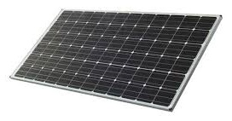
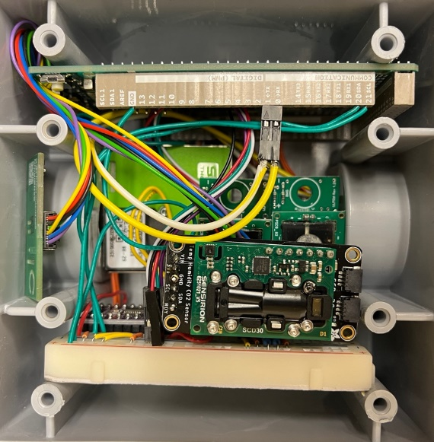

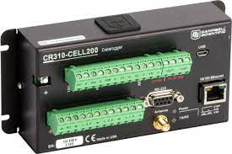
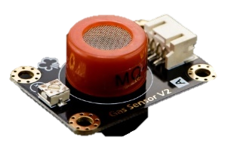
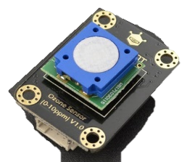
Desert Research Institute – NDEP collaboration
Expanding Wildfire Smoke Monitoring and Messaging into Rural Nevada
- - - - - - - - - - - - - - - - - - - - - - - - - - - - - - - - - - - - - - - - - - - - -
Air Quality Sensor Package
Solar module for power supply
Particulate Matter (PM)
Air Quality Sensor Package
CO
Ozone
VOC
Temp/RH
Data logging and communication
Notes:
Cell phone connection!

Slide 24
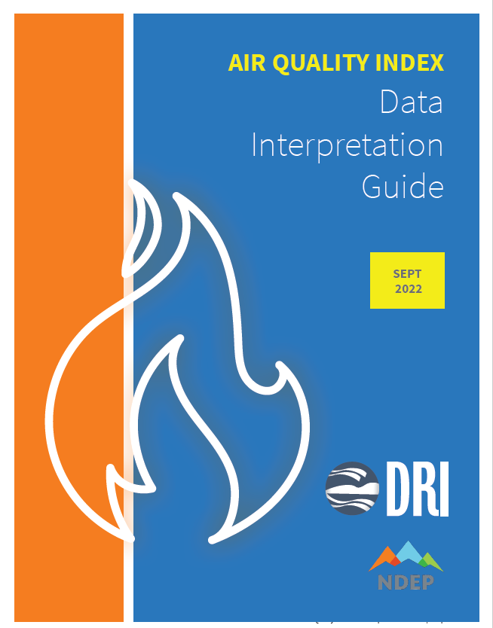
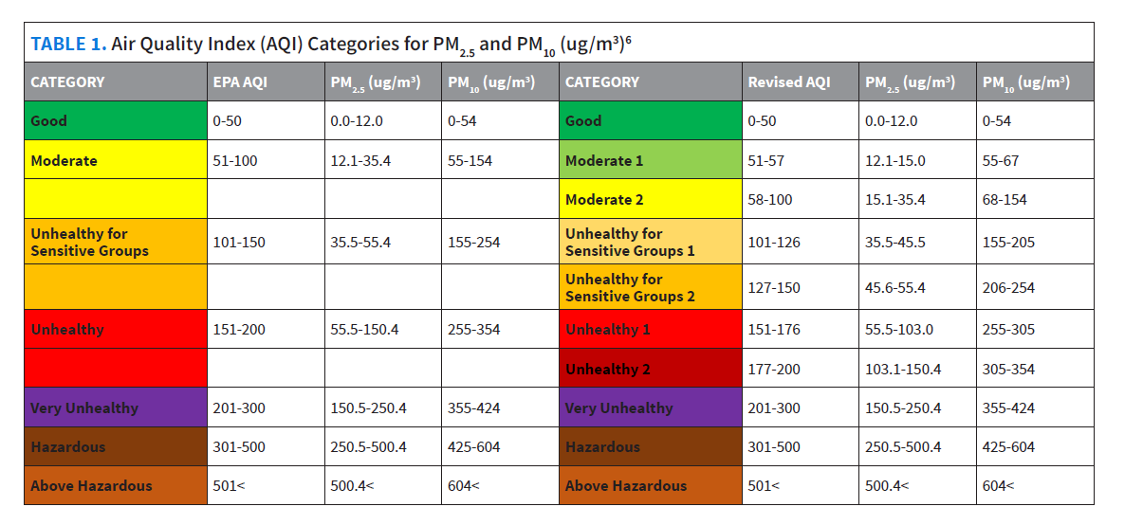
Desert Research Institute – NDEP collaboration
Expanding Wildfire Smoke Monitoring and Messaging into Rural Nevada
- - - - - - - - - - - - - - - - - - - - - - - - - - - - - - - - - - - - - - - - - - - - -
Data Interpretation Guide

Slide 25
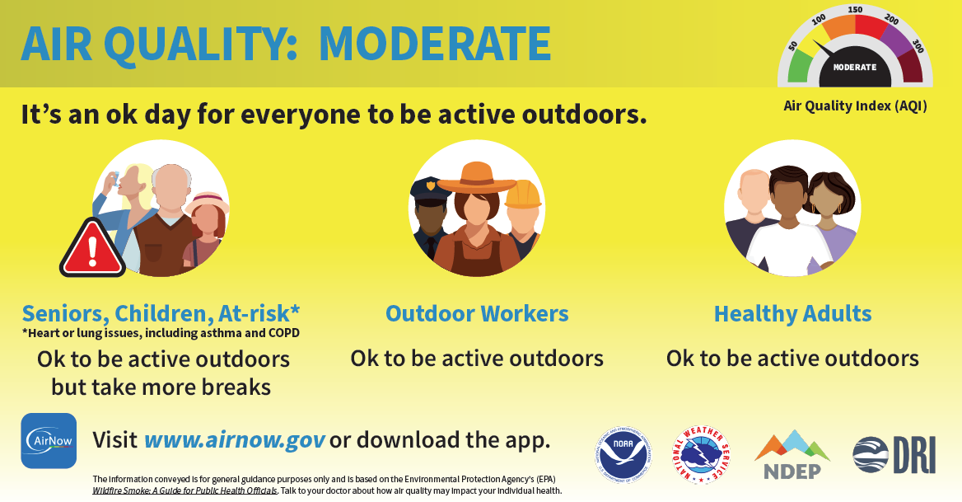
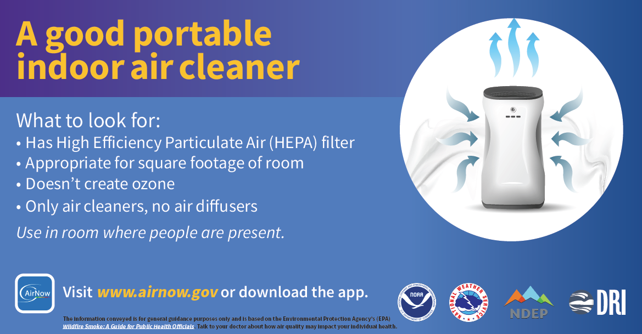

Desert Research Institute – NDEP collaboration
Expanding Wildfire Smoke Monitoring and Messaging into Rural Nevada
- - - - - - - - - - - - - - - - - - - - - - - - - - - - - - - - - - - - - - - - - - - - -
Infographics

Slide 26
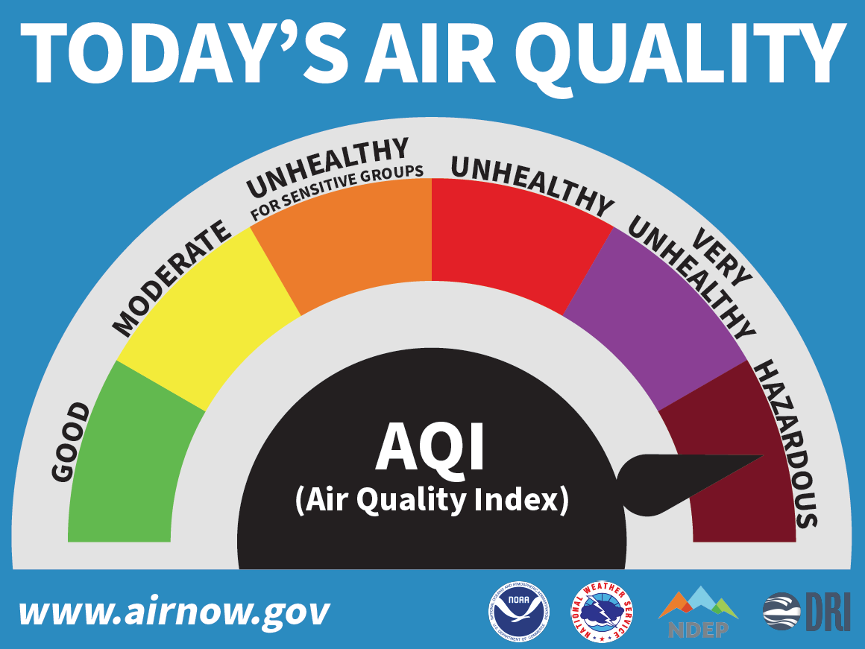
Desert Research Institute – NDEP collaboration
Expanding Wildfire Smoke Monitoring and Messaging into Rural Nevada
- - - - - - - - - - - - - - - - - - - - - - - - - - - - - - - - - - - - - - - - - - - - -
AQI Wall Dial
Data access for those not online
Available in:
  Senior Centers
  Libraries
  Courthouses
  Other public spaces

Slide 27

Contact
Questions?
Danilo Dragoni
Chief, BAQP-NDEP, DCNR
Email: ddragoni@ndep.nv.gov
website.nv.gov l @NevDCNR

