Slide 1
An Introduction to the Office of Advocacy Dave Rostker, Assistant Chief Counsel

Slide 2
WHO IS THE OFFICE OF ADVOCACY?
Created by Congress in 1976
Independent voice for small business in the federal government
Watchdog of the Regulatory Flexibility Act (RFA)
Source of small business statistics
Notes:
Who is the Office of Advocacy?
Independent voice for small business in the federal government.
A voice for small businesses before the White House, Congress, federal agencies, the courts, and state policymakers.
The watchdog of the Regulatory Flexibility Act (or RFA).
This statute requires agencies to consider small entities when they write regulations
The source of small business statistics.

Slide 3
The chief counsel
The Chief Counsel for Advocacy, a presidential appointee who is confirmed by the Senate, is the head of the Office of Advocacy.
Notes:
The Chief Counsel The Office of the Chief Counsel consists of the chief counsel for advocacy, a presidential appointee, confirmed by the Senate. The chief counsel for advocacy has a unique position in the federal government, charged by Congress to represent the views and interests of the nation’s 24.7 million business owners before federal policy makers.
The chief counsel directs Advocacy’s operations, which include conducting research on the U.S. small business sector, advocating for small businesses within the federal government’s agencies and rulemaking processes, reaching out to regional and state small business advocates and policymakers, and fostering public awareness of small business contributions and concerns.
Working under the direction of the chief counsel, the Office of Advocacy is divided into three primary offices: the Office of Economic Research, the Office of Interagency Affairs, and the Office of Information. In addition, the chief counsel oversees the work of the Regional Advocates in each of the SBA’s ten regions.

Slide 4
Advocacy departments
Interagency Affairs
Economic Research
Regional Advocates
Notes:
Interagency Affairs This legal team monitors federal regulatory and other activity with potential small entity impacts; and it works with agencies to help them develop better rules, both by soliciting small entity input early in the regulatory process and by crafting rules that mitigate adverse small entity effects where practicable, while still achieving agencies’ regulatory goals.
Economic Research The economists work with other agencies to acquire and analyze data, conduct in-house research, coordinate extramural contract research projects, and work closely with the legal team in Advocacy’s Office of Interagency Affairs to assess the costs of proposed federal rules and associated mitigation strategies.
Regional Advocates The advocates bring the tools and products developed by the Office of Advocacy and the federal government to the front door of business and make the knowledge gained available to state and local legislatures and councils. They play an important role, not only in carrying Advocacy’s message directly to the states, but also in identifying topics of concern to the small business community. They report to the director of regional affairs.

Slide 5
Advocacy’s mission
Regulatory Mission
Research Mission
Legislative Mission
Notes:
Regulatory Mission
Advocacy oversees compliance with the Regulatory Flexibility Act (RFA).
This law requires federal agencies to consider flexible approaches to achieve health, safety, and other regulatory goals.
Research Mission
We research small business issues and the small business economy. We sponsor and disseminate small business data and statistics.
Legislative Mission
We monitor proposed congressional legislation for its potential impact on small business.

Slide 6
Small business: Our Nation’s Job Creators
Employ 46.8% of the private workforce
Pay 39.7% of U.S. private payroll
99.7% of firms with paid employees
Created 62% of net new jobs since 1995

Slide 7
Small business challenges
Changes in operating costs and demands
Complex and costly federal regulations
Fewer resources to get involved in federal rulemaking process
Notes:
Small businesses face many costs and challenges.
New regulations can unduly burden small businesses with added complexity, paperwork, labeling, product redesign, costly outside expertise, licensing, training, and permits.
Small businesses lack the resources—time, personnel, expertise, and money—to get involved in the federal rulemaking process.

Slide 8
How advocacy represents small business
Small Business
Office of Advocacy
Congress
White House
Federal Agencies
Judicial
Notes:
Advocacy serves as a voice for small businesses before the White House, Congress, federal agencies, the courts, and state policymakers. If a small business has an issue with a proposed rule, or a proposed rule is likely to have a significant impact on a substantial number of small business, Advocacy represents these concerns to the federal government and proposes alternative solutions that will provide a solution to the problem the rule is trying to address without harming small business.

Slide 9
Advocacy’s role in RULEMAKING
ENSURE AGENCIES COMPLY WITH RFA
Communicate with agencies drafting regulations
Train agency officials on RFA COMPLIANCE
Help agencies develop less burdensome rules
Public comment letters to agencies
Regulatory alerts to small business stakeholders
SMALL BUSINESS OUTREACH

Slide 10
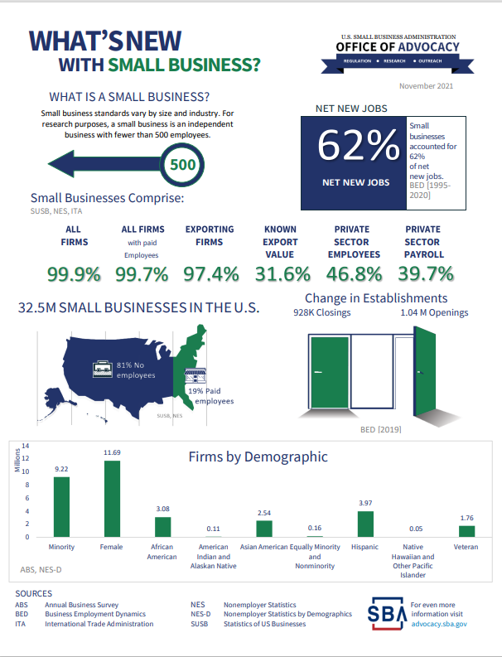
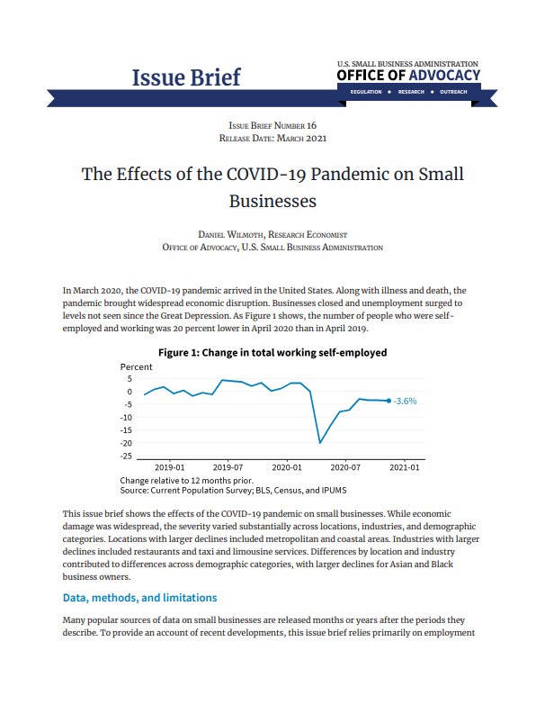
What does the office of economic research do?
Economic Studies
Issue Briefs
Fact Sheets
Infographics

Slide 11
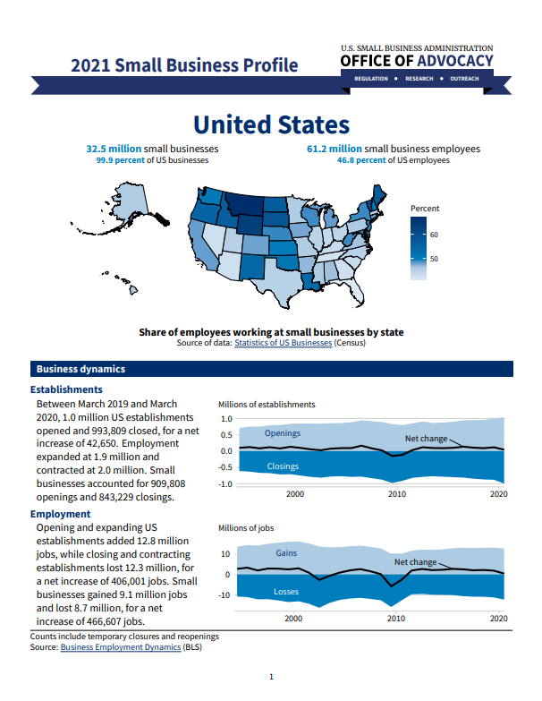
SMALL BUSINESS DATA
Economic Activity
Industry
Geographic Area
Firm Size
Characteristics of Businesses and Business Owners
Notes:
Economic Activity
Firms, establishments, employment, receipts, payroll
Industry
NAICS sectors (2 digit) and industries (6 digit)
Geographic Area
US, state, county, Congressional district, MSA
Firm Size
Employment size
Receipt size
Characteristics of Businesses
Characteristics of Business Owners

Slide 12
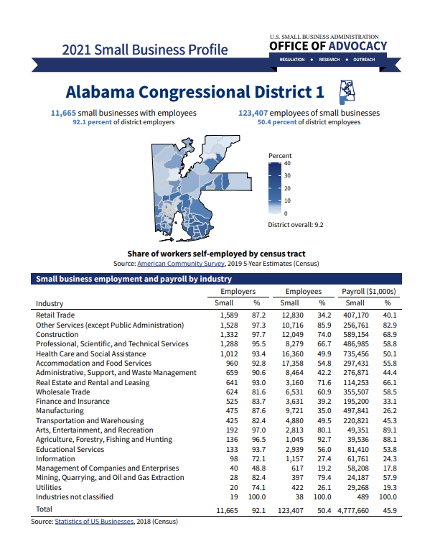
RESEARCH to aid small business
Small business profiles for each state and Congressional district
Research on:
Business turnover
Employment
Finance
Minority-, women-, and veteran-owned businesses.
Advocacy accepts research ideas from Congress, businesses, and the public

Slide 13
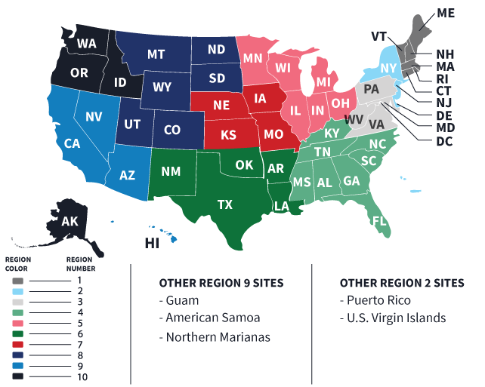
NATIONWIDE OUTREACH
10 Regional Advocates
Small business meetings around the nation
Small business input on effects of federal regulations
Provide feedback to agencies and Capitol Hill

Slide 14
SBA and Advocacy Compared
Advocacy
SBA
Voice small business concerns with proposed rules to federal government
MISSION
Support small business with disaster assistance, loans, and counseling
Help during rulemaking, finds alternatives to proposed rules
REGULATION
SBA Ombudsman helps small business with unfair enforcement of existing rules; Establishes SBA regulations
Chief Counsel for Advocacy, not involved in SBA litigation
LEGAL
Office of the General Counsel
10 regional advocates and 2 national advocates
OUTREACH
Network of 10 regional administrators and 50+ offices
Reports on small business data and impact of rules on small business
RESEARCH
Reports on SBA program data
N/A
LOANS
Various small business programs
Notes:
SBA vs. Advocacy
Mission:
Advocacy: Advocacy is an independent office in the federal government housed within SBA. The office advocates for small businesses by voicing their concerns with proposed regulations before the White House, Congress, and federal agencies. The office provides the public and lawmakers with sound economic research to support small business growth.
SBA: The U.S. Small Business Administration (SBA) is one of the federal government agencies under the executive branch. SBA supports small businesses through loan programs, disaster assistance and counseling, with the goals of preserving free competitive enterprise and strengthening the U.S. economy.
Assistance with Regulations:
Advocacy: Advocacy’s Office of Interagency Affairs helps during rulemaking. Finds and suggests alternatives to proposed federal rules.’
SBA: SBA Ombudsman helps with complaints about existing rules. Assists small businesses who feel harmed by federal practices and actions.
Federal Regulations:
Advocacy: Works directly with all federal agencies to suggest solutions or alternatives that achieve agency goals while easing the burden on small business.
SBA: Establishes SBA regulations and participates in the Office of Management and Budget approval process.

Slide 15
Advocacy and sba ombudsman compared
Advocacy and SBA Ombudsman Compared
Office of Advocacy
SBA National Ombudsman
Advocates for small business in rulemaking process
Helps small businesses with unfair enforcement of existing regulations
Independent Office
Impartial Liaison
Regional Outreach
Regulatory Fairness Boards
Notes:
SBA Ombudsman vs. Office of Advocacy
Unfair Regulatory Enforcement vs. Rulemaking Process
The Ombudsman helps small businesses who are subject to excessive or unfair federal regulatory enforcement of existing regulations.
This may include repetitive audits or investigations, excessive fines or penalties, threats, retaliation or other unfair enforcement action.
Advocacy works with federal agencies when they draft new regulations to avoid excessive small business regulatory burdens and finds alternatives to reduce the impact on small business.
Independent Office vs. Impartial Liaison
Advocacy acts as an independent office and advances the views and concerns of small business before Congress, the White House, federal agencies, federal courts, and state policymakers.
The Chief Counsel for Advocacy is appointed by the President and confirmed by the U.S. Senate.
The SBA Ombudsman is an office within SBA. They refer comments submitted by small business to the appropriate agency for a high-level fairness review. They work across the federal government to address small business concerns.
Regional Outreach vs. Regulatory Fairness Boards
Advocacy has 10 regional advocates. This team identifies issues and concerns of small business owners.
They work with local and state officials and legislators, and the Chief Counsel for Advocacy to develop programs and policies that support small business growth.
The SBA Administrator appoints 10 Small Business Regional Regulatory Fairness Boards.
The boards advise the Ombudsman on matters of federal regulatory concern to small businesses.
The Ombudsman coordinates the Regulatory Fairness Boards which help connect small businesses with resources available through the Ombudsman’s Office.
While the Office of Advocacy and the SBA Ombudsman work with different parts of the rulemaking process, they also often cooperate due to the similarity of their mission and goals to help small business.

Slide 16
Federal Rulemaking Process
The federal rulemaking process can be long and burdensome.
To clarify how the federal government enacts, or promulgates, a regulation, Advocacy has prepared A Basic Guide to Federal Rulemaking and Small Business

Slide 17
Step-by-step rulemaking process
Congress passes statute directing an agency to write a regulation.
An agency decides to create, replace, or update an existing regulation.
If the rule is from CFPB, EPA, or OSHA and will have a significant small business impact, the agency conducts a small business review panel (SBREFA panel) before publishing a proposed rule.
Agency develops proposed rule
OMB reviews proposed rule if “significant”
NO
RFA Requirement:
Will the rule have a major small business impact?
YES
Small entities can request Executive Order 12866 meetings to provide information on their businesses and how a rule could affect them.
Agency certifies the rule will not have a major small business impact and no further analysis is required.
Agency publishes an initial regulatory flexibility analysis (IRFA).
Agency publishes proposed rule in Federal Register
Public comment period
Small entities can submit comments to federal agencies during the public comment period.
Agency reviews comments and writes draft final rule
OMB reviews final draft rule
Agency publishes final rule in Federal Register & rule goes into effect.
(If an IRFA was required, the agency must include a final regulatory flexibility analysis.)

Slide 18
Advocacy’s role in the process
When establishing a rule, the question that must be asked:
Will the rule have a major small business impact? If the answer is “yes”, the RFA is required
The agency must prepare an initial regulatory analysis (IRFA) if it is determined that the proposal will cause a significant impact on a substantial number of small entities.
The final step in the process if it is determined the agency will cause a significant impact on a substantial number of small entities is the final regulatory flexibility analysis (FRFA)

Slide 19
COMMENT LETTERs
STEP 1
STEP 2
STEP 3
Comment to Agencies on Regulations.gov, or
provide input to Advocacy.
Comment on how much the rule will cost your small business.
Tell the agency what other options or alternatives it should consider.
Notes:
During the public comment period of the rule making process to see if the rule will have a significant impact on small business and small entities, the Office of Advocacy will submit a comment letter on the issue. Public feedback will allow agencies to understand the impact the proposed rule will have on small businesses.

Slide 20
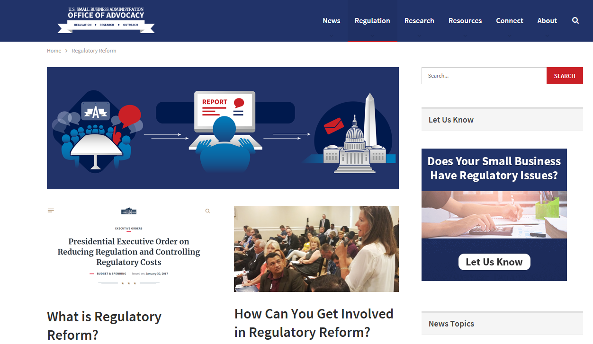
GETTING SMALL BUSINESSES INVOLVED
Small businesses can:
Contact our office with regulatory concerns
Subscribe to our email listservs for updates on regulations and key issues
Attend roundtables or small business forums in your area

Slide 21
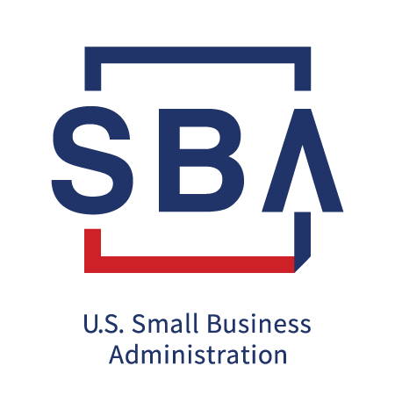
STAY IN TOUCH!
Dave Rostker
Assistant Chief Counsel
David.Rostker@sba.gov
202-205-6966

