Slide 1
Environmental Justice Subcommittee Update
Maxwell Graham
NJ SBEAP
National SBEAP Annual Training
March 21, 2023

Slide 2
Environmental Justice Subcommittee
Mission: Explore how SBEAPs/SBOs can address EJ concerns in their states through small business assistance.
Get involved!
Contact the Chair:
Lisa.AshenbrennerHunt@Wisconsin.gov
Notes:
Became permanent subcommittee Sept 2022.
Meets virtually on 2nd Tuesday each month at 2:00 Eastern.
Interested in getting involved? Contact Lisa Ashenbrenner Hunt, subcommittee chair, for more info

Slide 3
What is Environmental Justice?
U.S. EPA defines environmental justice as:
“the fair treatment and meaningful involvement of all people regardless of race, color, national origin, or income, with respect to the development, implementation and enforcement of environmental laws, regulations, and policies.”
Notes:
EJ is a priority for EPA and all federal agencies.

Slide 4
What does this mean for us?
SBEAPs/SBOs provide on-the-ground assistance to small businesses in communities with EJ concerns. Businesses may be owned by and/or employ members of these communities.
Small business want to know how they’ll be affected.
Businesses in communities with EJ concerns may see increased enforcement actions.
EJ concerns may influence permitting decisions.
This subcommittee looks for ways that small business assistance providers can integrate EJ considerations into their everyday work to reduce the burden on underserved communities while supporting small businesses in those communities.

Slide 5
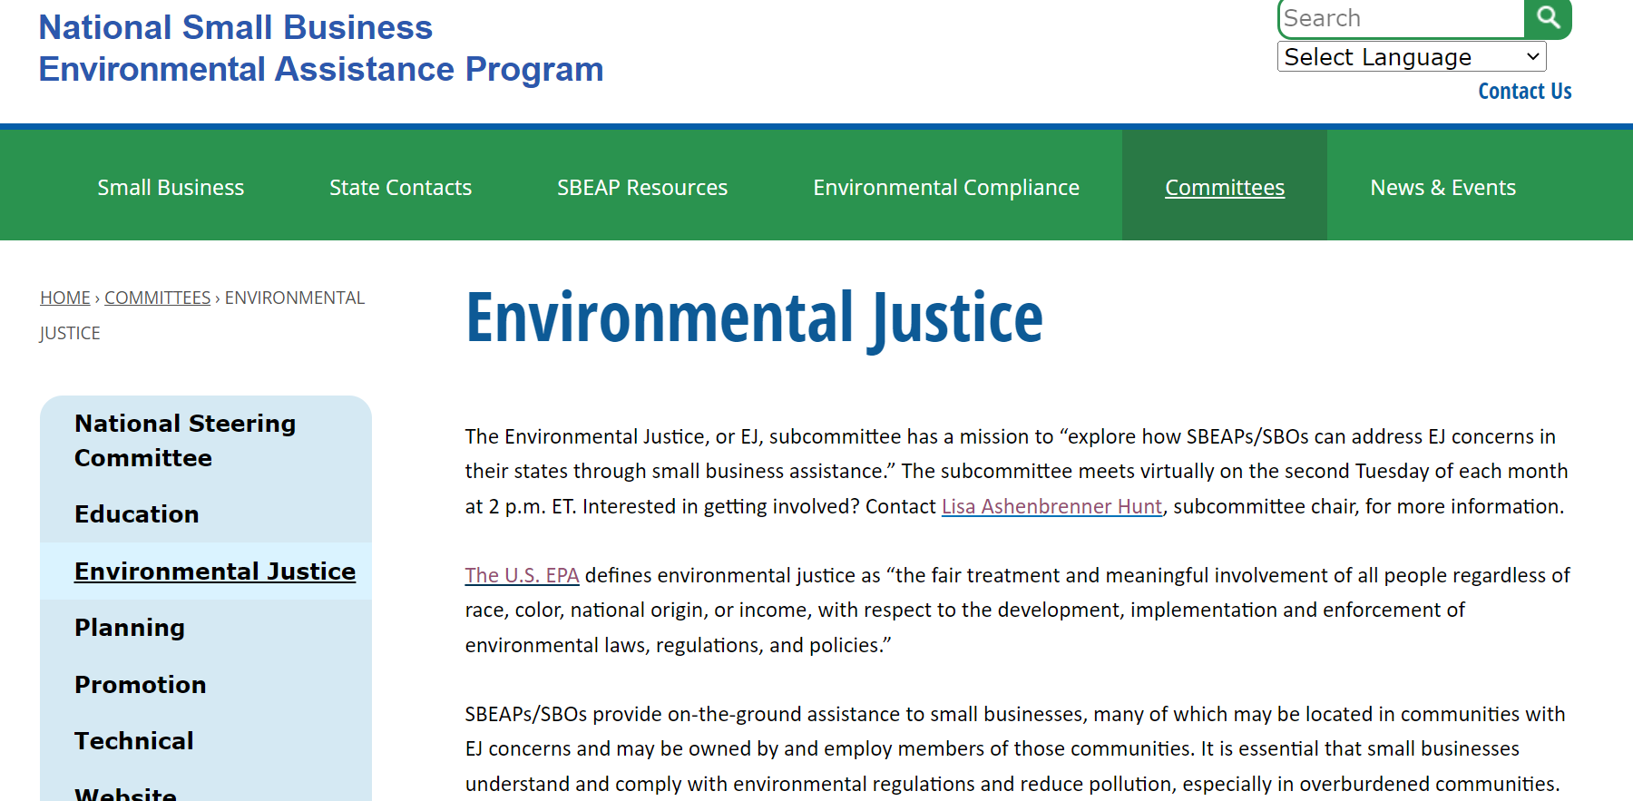
Environmental Justice | National Small Business Environmental Program (nationalsbeap.org)
Explore the map - Climate & Economic Justice Screening Tool (geoplatform.gov)
Notes:
Learn about environmental justice – recordings of EPA and other speakers
Environmental justice meeting records – combined minutes from calls
National Environmental Justice Advisory Council (NEJAC) involvement – info coming soon, NSC is supporting a nominee to represent SBEAPs
Environmental justice resources for SBEAPs/SBOs
Climate and Economic Justice Screening Tool will be go-to tool for all federal agencies; Interactive map and uses datasets that are indicators of burdens in eight categories: climate change, energy, health, housing, legacy pollution, transportation, water and wastewater, and workforce development.

Slide 6
Subcommittee Accomplishments
Organized informational presentations
Supported nomination of SBEAP representative to NEJAC
Organized discussions with EPA EJ office, Paula (Asbestos and Small Business Ombudsman), and other EPA staff on how SBEAPs can work with them and keep on top of their initiatives and priorities
Developed web resources to help you help businesses in EJ communities
Added EJ question to 2021 annual report, new question for 2022 to gauge what SBEAPs are already doing.
Notes:
2022 Annual Training Speaker Matthew Tejada – head of EPA EJ office, couple other presentations on web page
Annual report questions
2021 – are you doing any EJ-specific initiatives – most answered no
2022 – Are you tracking technical assistance you provide to customers who are part of a community with EJ concerns or otherwise dealing with EJ issues? How does your agency define communities with EJ concerns?

Slide 7
Potential Future Initiatives
Create resources for small businesses impacted by EJ efforts on how they can address concerns in their communities.
Explore how SBEAPs could target outreach to businesses in overburdened communities.
Provide guidance on translations/Title VI of Civil Rights Act./etc. – How can we ensure our resources and assistance are accessible?
Develop case studies on how SBEAPs help small businesses in EJ communities.
Continue exploring how to work with EPA EJ office and other programs to address small business and EJ concerns.
Explore how cumulative impacts of multiple stressors impact communities and businesses.
Notes:
EPA’s focus on cumulative impacts could pull in more small businesses, since they’ll looking at all businesses in an impacted community

Slide 8
We want to hear from you!
Have you received questions from small businesses specific to EJ? What were they asking?
What EJ-related topics would you like training on?
What EJ tools or resources would you find most helpful?
Do you conduct outreach in other languages? Which one(s)?
Have you had interactions with your agency’s EJ contact (if you have one)?
Have you taken any steps to advance Environmental Justice in your state? What steps?

