Slide 1
2016 National Steering SBO/SBEAP Awards Ceremony May 3, 2016

Slide 2
2016 National Steering SBO/SBEAP Awards
The NSC Awards are the States’ premier environmental awards program for recognizing outstanding environmental performance, programs and individual(s). These awards honor and recognize small businesses, individuals, trade associations and others who have made significant contributions to protecting the environmental

Slide 3
2016 Awards Subcommittee
Sara Johnson, Region 1
Edward Bakos, Region 2
Nancy Crickman, Region 3
Jeremy Hancher , Region 3
Nancy Herb, Region 3
Tony Pendola, Region 4
Renee Bashel, Region 5
Dan Nickey, Region 7
Jenna Latt, Region 9
Patrick Hoermann, Region 10

Slide 4
2016 Award Categories
Small Business Environmental Assistance Program Award
Small Business Environmental Stewardship Award
Small Business Trade Association Environmental Leadership
Karen V. Brown Award Environmental Leadership Award

Slide 5
2016 Small Business Environmental Assistance Program Award
Recognizes exemplary performance in one or more areas where individuals and programs have contributed their time, created resources and work products, promoted policy advancements, developed program innovations, and established new partnerships to build a strong network of small business assistance. The SBEAP emphasize state program leadership or individual leadership.

Slide 6
Accomplishments
SBEAP has worked over the years to improve the compliance levels of small businesses.
SBEAP actively participates in the Regional group’s monthly calls and the National Steering Committee’s subcommittees and on the NSC itself and in chairing committees.
Serves as the NSC representative on the ECOS Next Generation Compliance workgroup and previously served as an appointed member of the USEPA’s NACEPT committee on Compliance Assistance.
SBEAP staff developed an inspection checklist for inspectors to use for the RICE rule and refreshed them on the 6H standards

Slide 7
Accomplishments
Taken the lead in assisting small businesses Registration of Smaller Sources (ROSS) The ROSS program is designed to simplify air regulatory requirements by requiring sources with low actual emissions to register with the Agency rather than acquiring an air permit.
Hosted the SBEAP Annual Training
Presented multiple times at the SBEAP conferences
Educate and speak at chamber of commerce groups to industry associations – to work to educate impacted industries of their environmental regulatory requirements.
Notes:
(It is important to note that although the source may no longer be subject to permitting requirements, the source must still comply with all applicable environmental laws and regulations. This change to the permit process resulted in a decrease in the reporting burden for many small sources)

Slide 8
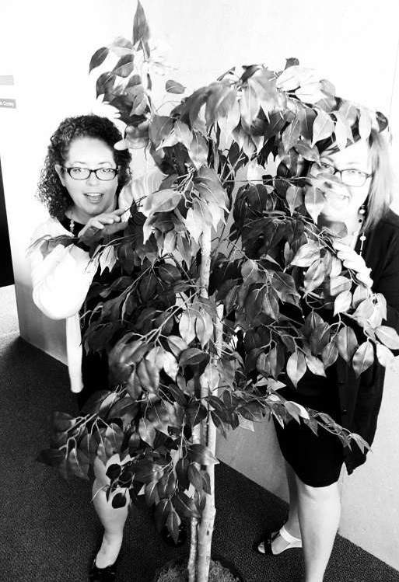
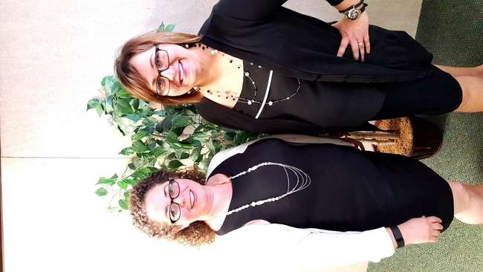
2016 Small Business Environmental Assistance Program Award
Both Annette Fulgenzi and Erin Conley
Illinois Small Business Environmental Assistance Program (SBEAP)

Slide 9
2016 Small Business Environmental Stewardship Award
Recognizes exemplary performance in pollution prevention, leadership, industrial environmental leadership, and community environmental leadership.
The nominee(s) must have worked with their local, state/territorial, or national SBO/SBEAP in these efforts.

Slide 10
Compliance Assistance and Sustainable efforts
Hazardous waste inspection from the Department of Health and Environment
SBEAP provided on-site and phone/email assistance, helping the business understand and comply with air and waste regulations. SBEAP helped with emissions calculations, permit applications and emissions inventory submittals
The business improved its processes and reduced its environmental footprint. Environmental goals went from being expensive and painful, to affordable and achievable.

Slide 11
Henke Manufacturer Sustainable efforts
Determined the business was subject to Subpart MMMM, Metal Parts and Products rule
Hired an environmental compliance officer.
Learned about and applied for an air permit.
Learned about reporting, relevant laws and actions needed to be taken monthly, annually, the business improved its processes and reduced its environmental footprint. The buisness has gone beyond environmental compliance
Each year the business participates in the Kansas Environmental Conference, sharing information with other industry experts
The business participates in a work release program for prison inmates that was started by the Workman’s Fund
The buisness participated in the K-State Pollution Prevention Institute Environmental Sustainability

Slide 12
2016 Small Business Environmental Stewardship Award

Slide 13
Small Business Trade Association Environmental Leadership
This award category offers an opportunity to showcase the accomplishments of a Trade Association nationwide in the areas of compliance assistance, sustainability, advocacy, and collaboration

Slide 14
Accomplishments
Trade Association has worked with Kansas, Wisconsin, and New Hampshire.
Provides compliance educational materials to its members and responds to individual requests for assistance.
Hotline for EHS and related technical inquires responding to over 2,000 inquiries from members, affiliates, and regulatory agencies each year
Over 15 presentations using several approaches including webinars, workshops, conferences, and seminars in 2015

Slide 15
Accomplishments
Conducted over 40 on-site facility visits
Articles on EHS topics for the member publication, As part of the education and outreach efforts on compliance, Trade Association, also includes sustainability information.
Distributing timely and educational EHS information via the comprehensive Sustainable and Regulatory Affairs listserv
Continued to support the Printer’s National Environmental Compliance Assistance Center (www.pneac.org)
Trade Association is a founding partner in the Sustainable Green Printing Partnership (SGP)

Slide 16
Small Business Trade Association Environmental Leadership
Printing Industries of America

Slide 17
2016 Karen V. Brown Award Environmental Leadership Award
The recipient of this award demonstrates a pattern of providing consistent growth and positive outcomes above and beyond the scope of normal duties.
Recognizes exemplary performance in one or more areas where the individual have contributed their time, created resources and work products, promoted policy advancements, developed program innovations, and established new partnerships to build a strong network of small business assistance. The SBEAP emphasize state program leadership or individual leadership.

Slide 18
2016 Karen V. Brown Award Environmental Leadership Award
Advocate for small businesses on the national, regional, state and local level for more than twenty years
Strong voice in support of small businesses
Style and commitment has resulted in him being recognized as a mentor and leader that is recognized for his practical approaches to help small businesses and the environment.

Slide 19
2016 Karen V. Brown Award Environmental Leadership Award
Chair of the NSC’s Technical Workgroup, as well as co-chair from 2012-2015
Region V Auto Body Environmental Results Program conducted from 2009 to 2012.
Instrumental in developing General Permits, Permit-by-rules and new small source exemptions that typically impact small businesses
A sign of a good leader is to listen, offer support, and learn from others.

Slide 20
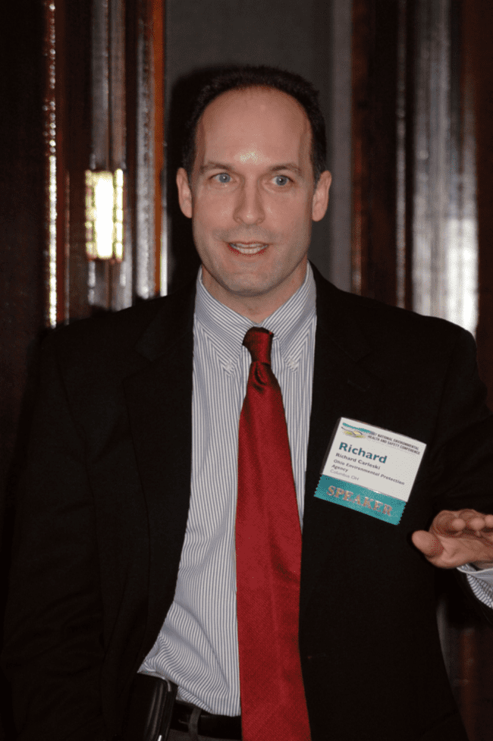
2016 Karen V. Brown Award
Rick Carleski (R5),
Joined the Air Force
F16 Fighter Pilot

